Slide 1
BEACONS INDOOR POSITIONING SYSTEM
Canepa Andrea
Masi Giacomo
Rebora Stefano

Slide 2
TOOLKIT
Frameworks, Technology and techniques
2

Slide 3
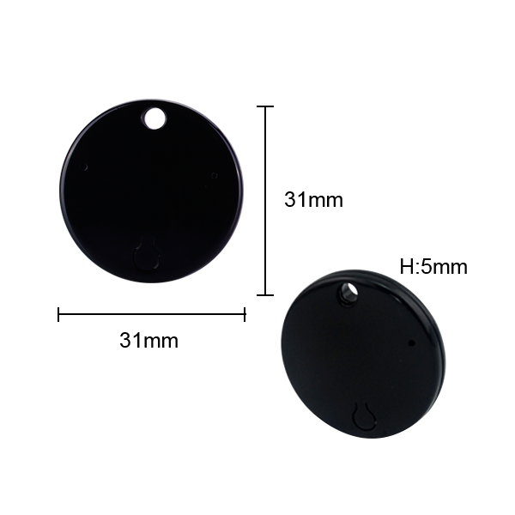

iBEACONS
AXAET iBeacon PC032
https://axaet.en.alibaba.com/product/60344453945-801451216/AXAET_PC032_Mini_Beacon_Bluetooth_Ble_4_0_iBeacon_With_ABS_Plastic_Case.html
A beacon is a small low-cost bluetooth radio transmitter
It broadcasts a radio signal that is made up of a combination of letters and numbers

Slide 4
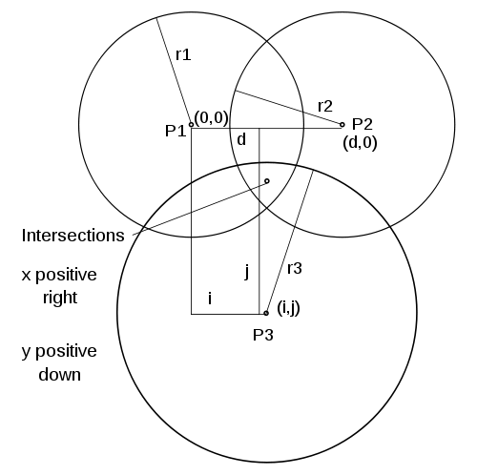
TRILATERATION ALGORITHM
Trilateration is the process of determining absolute or relative locations of points by measurement of distances, using the geometry of circles, spheres or triangles

Slide 5



REACTNATIVE
React Native framework lets you build native mobile apps (iOS & Android) using Javascript and React
https://github.com/MacKentoch/react-native-beacons-manager

Slide 6

NODE.JS
Node.js is an open-source, cross-platform JavaScript run-time environment that executes JavaScript code server-side.
Lightweight
Efficient

Slide 7
ARCHITECTURE
Let’s put the things together
7

Slide 8
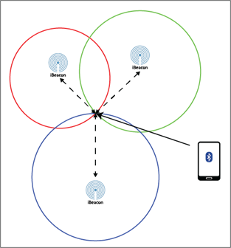

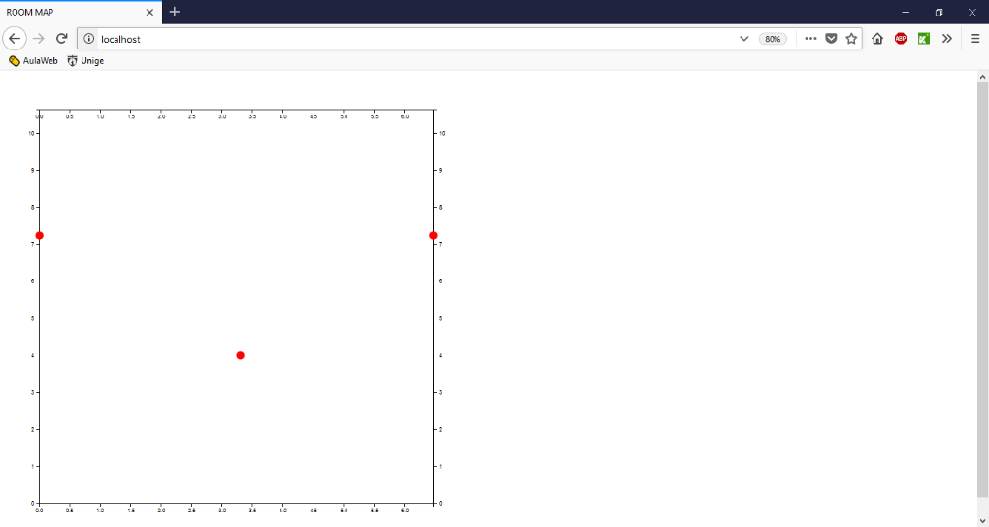
POST
GET
WEB SOCKET

Slide 9
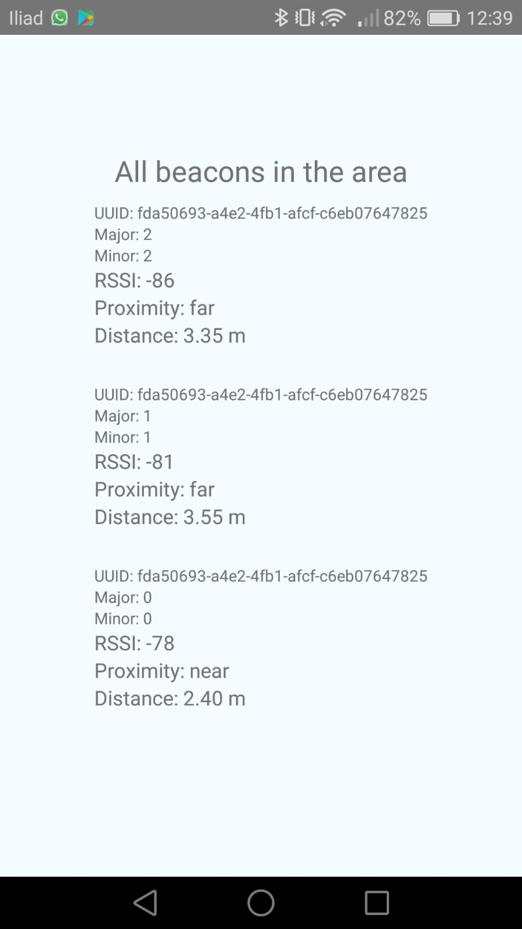
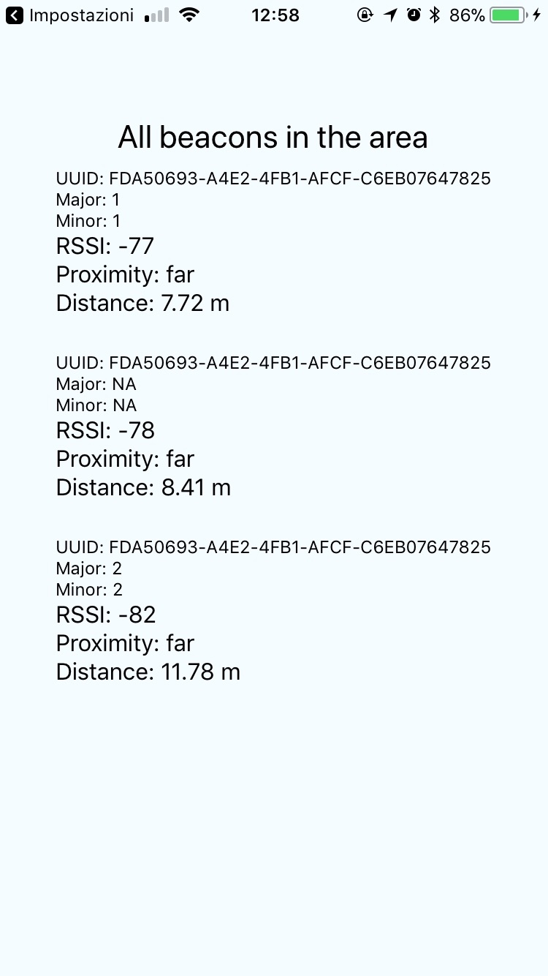

Slide 10
SETUP AND RESULTS
Room’s setup and collected results
9

Slide 11
1° Setup
Y
Beacon | X | Y
Beacon 0 | 0 | 9.69
Beacon 1 | 6.47 | 4.65
Beacon 2 | 2 | 1
10.65 m
2° Setup
Beacon | X | Y
Beacon 0 | 3.97 | 9.85
Beacon 1 | 6.47 | 7.9
Beacon 2 | 0 | 7.9
X
6.47 m
* Room 710, 7° floor (DIBRIS)

Slide 12

1° SETUP
REAL COORDINATES |  | ANDROID COORDINATES |  | iOS COORDINATES
X | Y | X | Y | X | Y
1.0 | 8.69 | 1.35 | 5.75 | 0 | 10.65
5.47 | 8.69 | 3.72 | 7.81 | 5.53 | 10.65
3.23 | 5.32 | 3.41 | 4.73 | 5.20 | 8.67
1.0 | 2.50 | 2.12 | 4.94 | 5.38 | 0.92
5.47 | 2.50 | 2.65 | 5.77 | 6.47 | 0

Slide 13
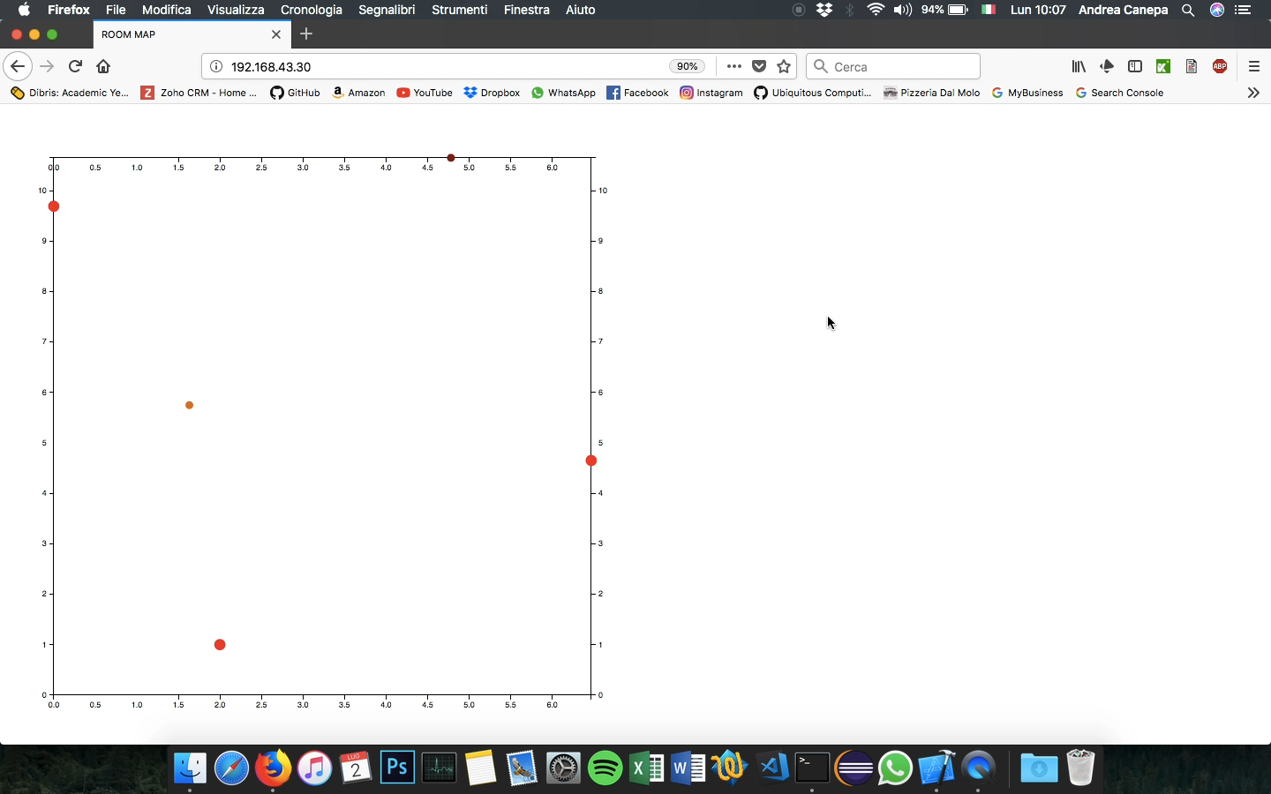

Slide 14
2° SETUP
REAL COORDINATES |  | ANDROID COORDINATES |  | iOS COORDINATES
X | Y | X | Y | X | Y
1.0 | 8.69 | 2.79 | 4.89 | 0.47 | 0
3.23 | 8.69 | 3.41 | 5.67 | 2.31 | 9.76
5.57 | 8.69 | 3.49 | 5.36 | 6.47 | 1.02
3.23 | 5.32 | 3.43 | 6.06 | 3.6 | 5.03

Slide 15
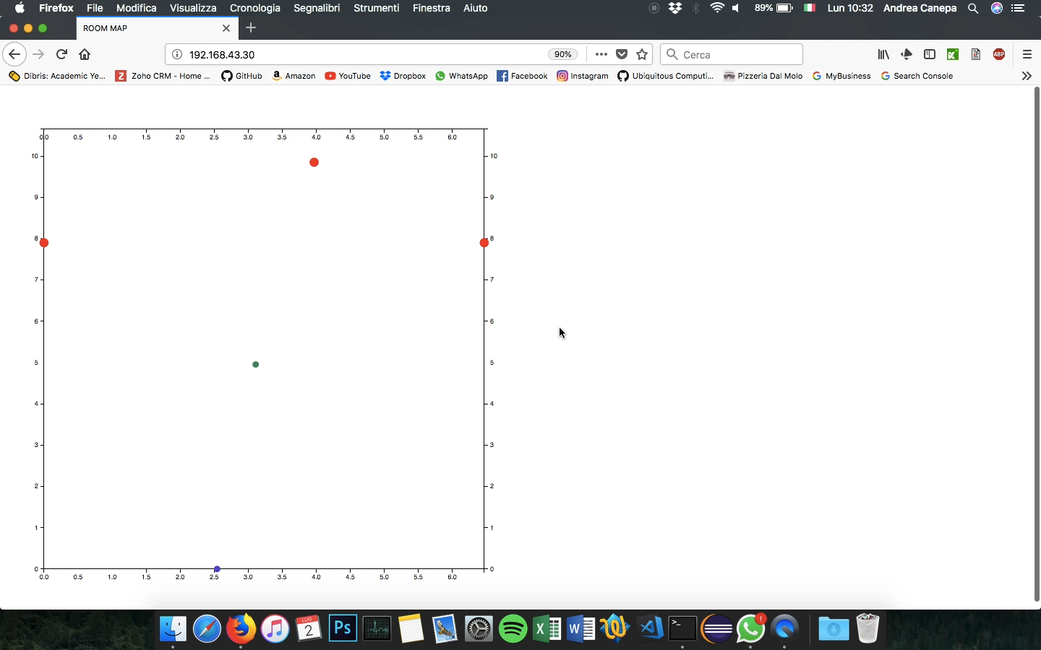

Slide 16
PROBLEM FACED AND TECHNOLOGY LIMITATIONS
Signal interference, environment and technology limitations
15

Slide 17
ALGORITHM FOR DISTANCE ESTIMATION ON ANDROID
Algorithm developed by Apple is not open source
AltBeacon Android library offers only an approximation
Variable distance estimation
1 meter –> 0.5 - 2 meters of variation
20 meters -> 10 - 40 meters of variation

Slide 18
INTERFERENCES AND REFLECTIONS
Position estimation based on transmission power of the signal
Interferences caused by power sources, metallic objects, wireless devices, phones and so on
Impossible to completely remove them

Slide 19
DEVICE LIMITATIONS
Low-cost devices
Limited transmit-distance
Limited transmit-power and consequent vulnerability to interferences

Slide 20
CONCLUSIONS
Results and future work
19

Slide 21
RESULTS
Accuracy achieved not satisfactory
Different behaviour for Android : position tends to be always in the middle area of the three beacons
iOS : more realistic distances but often affected by the floating RSSI due to interferences

Slide 22
POSSIBLE FUTURE WORK
Try different environment
Try different beacons, SDK
Apply a Machine Learning algorithm (e.g. Neural Network) to refine the position computed by the trilateration algorithm.
* training dataset generation problem

Slide 23
THANKS!

